Slide 1
BANK DATABASE MANAGEMENT SYSTEM
BY SANDEEP KUMAR VAISHYA

Slide 2
CREATE DATABASE BANK_MANAGEMENT_SYSTEM; →CREATING DATABASENAME=BANK_MANAGEMENT_SYSTEM
USE BANK_MANAGEMENT_SYSTEM; → USING CURRENT DATABASE
CREATE TABLE CUSTOMER_PERSONAL_INFO(
CUSTOMER_ID INT PRIMARY KEY,
NAME VARCHAR(30),
AGE INT , →CREATING TABLE FOR CUSTOMER PERSONAL INFORMATION
DOCUMENT_ID VARCHAR(100),
ADDRESSS VARCHAR(50),
GENDER VARCHAR(1),
ACCOUNT_NO VARCHAR(100)
);

Slide 3
CREATE TABLE BANK_INFO(
BANK_NAME VARCHAR(40),
BANK_BRANCH VARCHAR(100), CREATING TABLE FOR BANKS INFORMATION
BANK_IFSC VARCHAR(100) PRIMARY KEY
);
CREATE TABLE TRANSACTION_INFO(
TRANSACTION_ID INT PRIMARY KEY AUTO_INCREMENT,
RECIEVER_ACCOUNT_NO VARCHAR(100),
SENDER_ACCOUNT_NO VARCHAR(100),
CUSTOMER_ID INT , CREATING TABLE FOR TRANSACTIONS INFORMATIONS
BANK_IFSC VARCHAR(100) ,
TRANSACTION_TIME varchar(100),
TRANSACTION_AMOUNT INT,
FOREIGN KEY(CUSTOMER_ID) REFERENCES CUSTOMER_PERSONAL_INFO(CUSTOMER_ID),
FOREIGN KEY(BANK_IFSC) REFERENCES BANK_INFO(BANK_IFSC)
);

Slide 4
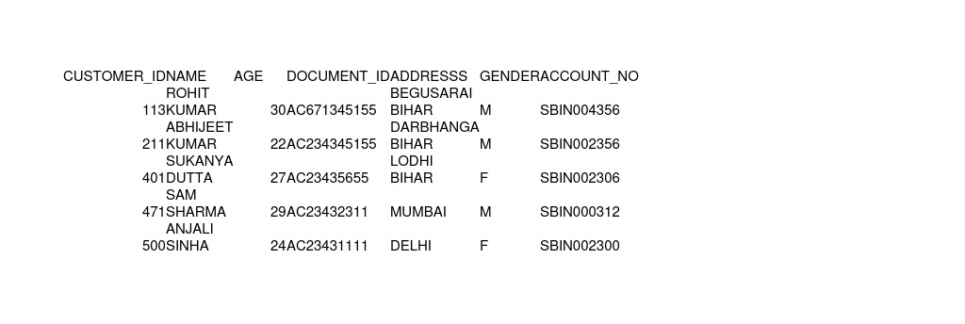
INSERT INTO CUSTOMER_PERSONAL_INFO VALUES(211,"ABHIJEET KUMAR",22,"AC234345155","DARBHANGA BIHAR","M","SBIN002356");
INSERT INTO CUSTOMER_PERSONAL_INFO VALUES(113,"ROHIT KUMAR",30,"AC671345155","BEGUSARAI BIHAR","M","SBIN004356");
INSERT INTO CUSTOMER_PERSONAL_INFO VALUES(401,"SUKANYA DUTTA",27,"AC23435655","LODHI BIHAR","F","SBIN002306");
INSERT INTO CUSTOMER_PERSONAL_INFO VALUES(471,"SAM SHARMA",29,"AC23432311","MUMBAI","M","SBIN000312");
INSERT INTO CUSTOMER_PERSONAL_INFO VALUES(500,"ANJALI SINHA",24,"AC23431111","DELHI","F","SBIN002300");

Slide 5
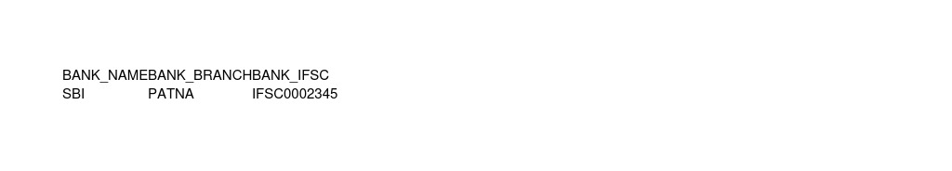
INSERT INTO BANK_INFO VALUES("SBI","PATNA","IFSC0002345");
INSERT INTO TRANSACTION_INFO VALUES(1,"SBIN002356","SBIN002306",401,"IFSC0002345",CURRENT_TIMESTAMP(),20000);
INSERT INTO TRANSACTION_INFO VALUES(2,"SBIN002306","SBIN002300",500,"IFSC0002345",CURRENT_TIMESTAMP(),70000);
INSERT INTO TRANSACTION_INFO VALUES(3,"SBIN002306","SBIN002356",211,"IFSC0002345",CURRENT_TIMESTAMP(),60000);
INSERT INTO TRANSACTION_INFO VALUES(4,"SBIN000312","SBIN002306",401,"IFSC0002345",CURRENT_TIMESTAMP(),10000);
INSERT INTO TRANSACTION_INFO VALUES(5,"SBIN004356","SBIN000312",471,"IFSC0002345",CURRENT_TIMESTAMP(),12000);

Slide 6
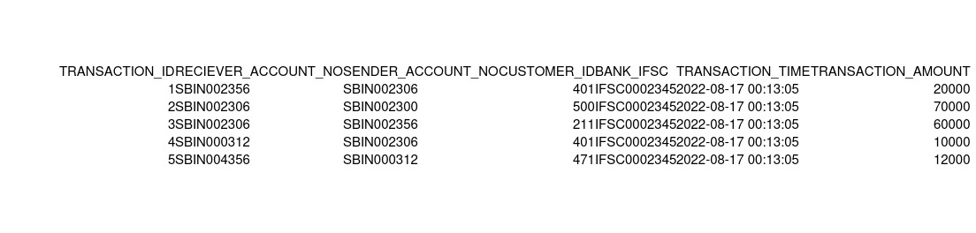
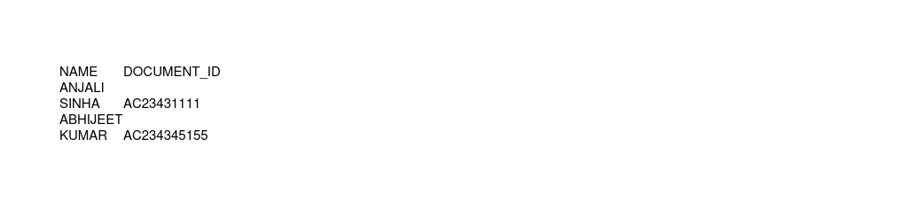
FIND ALL CUSTOMERS ALONG WITH THEIR DOCUMENT_ID WHO MADE THE TRANSACTION WITH AMOUNT>20000
SELECT CUSTOMER_PERSONAL_INFO.NAME,CUSTOMER_PERSONAL_INFO.DOCUMENT_ID FROM CUSTOMER_PERSONAL_INFO
INNER JOIN TRANSACTION_INFO ON CUSTOMER_PERSONAL_INFO.CUSTOMER_ID =TRANSACTION_INFO.CUSTOMER_ID
WHERE TRANSACTION_AMOUNT>20000;

Slide 7
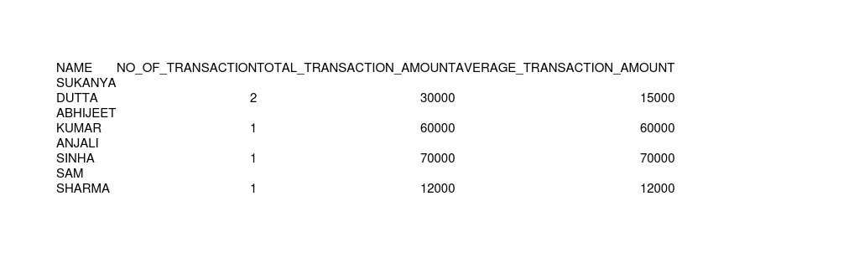
QUERY THE NAME OF CUSTOMER , THEIR NO. OF TRANSACTION , TOTAL TRANSACTION AND AVERAGE TRANSACTION AMOUNT ORDER BY NO. OF TRANSACTION IN DESCENDING ORDER;
SELECT CUSTOMER_PERSONAL_INFO.NAME,COUNT(TRANSACTION_ID) AS NO_OF_TRANSACTION ,SUM(TRANSACTION_AMOUNT) AS TOTAL_TRANSACTION_AMOUNT, AVG(TRANSACTION_AMOUNT) AS AVERAGE_TRANSACTION_AMOUNT FROM TRANSACTION_INFO
LEFT JOIN CUSTOMER_PERSONAL_INFO ON TRANSACTION_INFO.CUSTOMER_ID= CUSTOMER_PERSONAL_INFO.CUSTOMER_ID
GROUP BY TRANSACTION_INFO.CUSTOMER_ID
ORDER BY COUNT(TRANSACTION_ID) desc, CUSTOMER_PERSONAL_INFO.NAME ;

